Slide 1
CAP STONE PROJECT
CSA5154-CRYPTOGRAPHY AND NETWORK SECURITY FOR modern cryptography
FROM:
L.SAI MANAS REDDY(192210293)
T. Prudhvi sai(192210501)
SUPERVISOR:
DR S GOMATHI

Slide 2
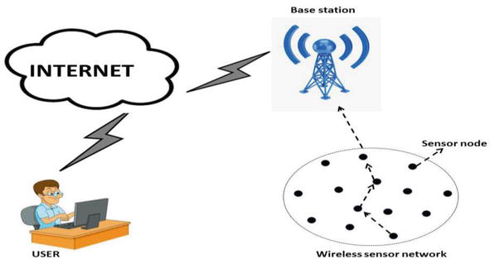
ENHANCING WIRELESS NETWORK SECURITY

Slide 3

INDEX
Introduction
Objectives
Project Scope
Methodology
Expected Outcomes
Resources Required
Potential Challenges
Source code
output
Conclusion

Slide 4
Introduction:
Wireless networks are pervasive in modern communication systems, making them a prime target for cyber-attacks.
Enhancing their security is critical to protect sensitive data and ensure reliable communication.
This capstone project aims to develop and implement a comprehensive security framework for wireless networks, incorporating cutting-edge techniques and best practices.

Slide 5
Objectives:
Analyze Current Wireless Security Protocols: Examine the strengths and weaknesses of existing protocols like WEP, WPA, WPA2, and WPA3.
Identify Vulnerabilities: Conduct vulnerability assessments to identify common attack vectors such as man-in-the-middle attacks, packet sniffing, and unauthorized access.
Develop Enhanced Security Solutions: Design and implement advanced security measures, including encryption enhancements, robust authentication mechanisms, and intrusion detection systems.
Evaluate Performance: Assess the performance and effectiveness of the proposed security solutions through rigorous testing and simulations.

Slide 6
Project scope:
The project will cover the following key areas:
Wireless Network Protocols: In-depth analysis of current standards and security features.
Vulnerability Assessment: Identifying potential weaknesses in wireless networks using tools like Wireshark and Aircrack-ng.
Security Solution Design: Proposing new or enhanced security measures, potentially involving machine learning for anomaly detection and blockchain for secure authentication.
Implementation and Testing: Building a prototype network to implement and test the proposed solutions.

Slide 7
Methodology:
Literature Review: Study existing research on wireless network security to understand the current landscape and identify gaps.
Tools and Technologies:
Network Simulation Tools: NS-3, OMNeT++
Security Testing Tools: Wireshark, Aircrack-ng, Metasploit
Machine Learning Libraries: TensorFlow, Scikit-learn
Blockchain Frameworks: Hyperledger, Ethereum
Vulnerability Analysis: Use penetration testing tools to simulate attacks and identify vulnerabilities.
Design and Implementation: Develop new security protocols or enhance existing ones, incorporating advanced technologies like AI and blockchain.
Testing and Evaluation: Perform extensive testing using simulation tools and real-world scenarios to evaluate the effectiveness of the proposed solutions.

Slide 8
Expected Outcomes
A comprehensive report detailing the analysis of current wireless security protocols and identified vulnerabilities.
A prototype of the enhanced security solution for wireless networks.
Performance evaluation results demonstrating the effectiveness of the proposed solution.
Recommendations for deploying the enhanced security framework in real-world scenarios.

Slide 9

Resources Required
Software: Network simulators (NS-3, OMNeT++), security testing tools (Wireshark, Aircrack-ng), machine learning libraries (TensorFlow, Scikit-learn), blockchain frameworks (Hyperledger, Ethereum).
Hardware: Wireless routers, access points, computers for setting up test networks.
Literature and Documentation: Access to academic journals, whitepapers, and industry reports on wireless network security.

Slide 10
Potential Challenges:
Complexity of Wireless Networks: Ensuring comprehensive coverage of various types of wireless networks.
Evolving Threat Landscape: Keeping up with the latest attack vectors and security threats.Integration of Advanced
Technologies: Seamlessly integrating machine learning and blockchain technologies into the security framework.

Slide 11
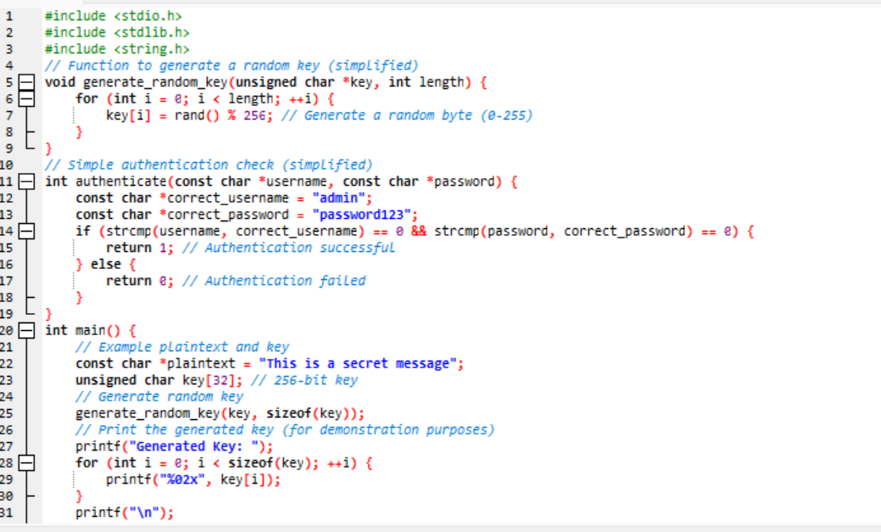
Source code:

Slide 12
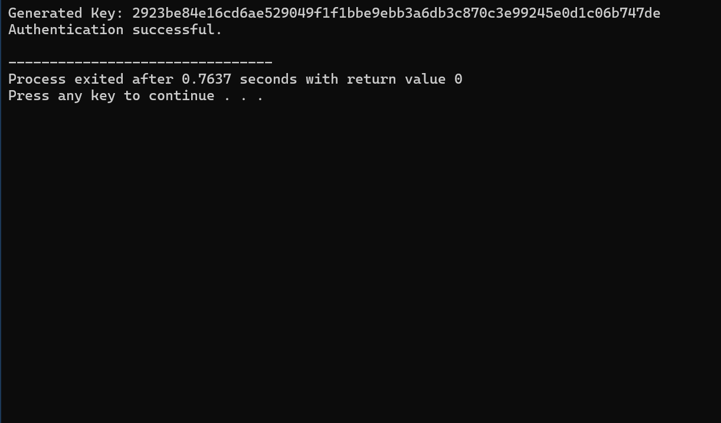
Output:

Slide 13
APPLICATIONS
Upgrade to WPA3:
Utilize the latest Wi-Fi security protocol, WPA3, which provides stronger encryption and better protection against brute-force attacks.
Implement 802.1X Authentication:
Use 802.1X for network access control, supported by a RADIUS server for secure user and device authentication, often employing digital certificates.
Use Virtual Private Networks (VPNs):
Encrypt data transmission with VPNs for remote access, ensuring secure communication between remote devices and the corporate network.
Deploy Intrusion Detection and Prevention Systems (IDPS):
Monitor network traffic with IDPS to detect and respond to suspicious activities and potential threats.
Enable Rogue Access Point Detection:
Utilize Wireless Intrusion Prevention Systems (WIPS) to identify and mitigate unauthorized access points.
Segment the Wireless Network:
Create separate networks for guests and internal users, and use VLANs to isolate and protect different segments of network traffic.

Slide 14
Conclusion
This capstone project aims to significantly enhance the security of wireless networks by identifying vulnerabilities and developing robust solutions.
By leveraging advanced technologies such as AI and blockchain, the project will contribute to creating more secure and reliable wireless communication systems.
Enhance wireless network security by using strong encryption (preferably WPA3), changing default router credentials, and keeping firmware updated.
Enable firewalls, disable unnecessary features like WPS and remote management, and use a complex Wi-Fi password.
Set up a guest network, enable MAC address filtering, and regularly monitor for unusual activity. Educate users on security practices and ensure IoT devices are secure.

Slide 15


